Slide 1






Pridis – Differentiate & Add Value
Bridging the portfolio gaps …
Marco Cornet
+31 (0)33 247 5700
mcornet@pridis.com
www.pridis.com
May 2011

Slide 2

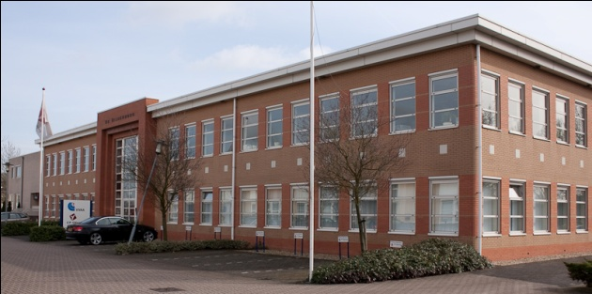



About Pridis
Founded in 1994
Based in Nijkerk, The Netherlands
Products, Consultancy, Professional Services
Telephony and Data Integration expertise
Professional Software Development House
Partners in more than 14 country’s worldwide
Part of

Slide 3
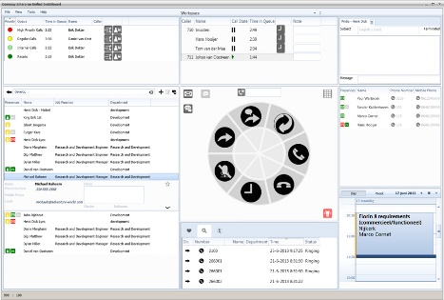
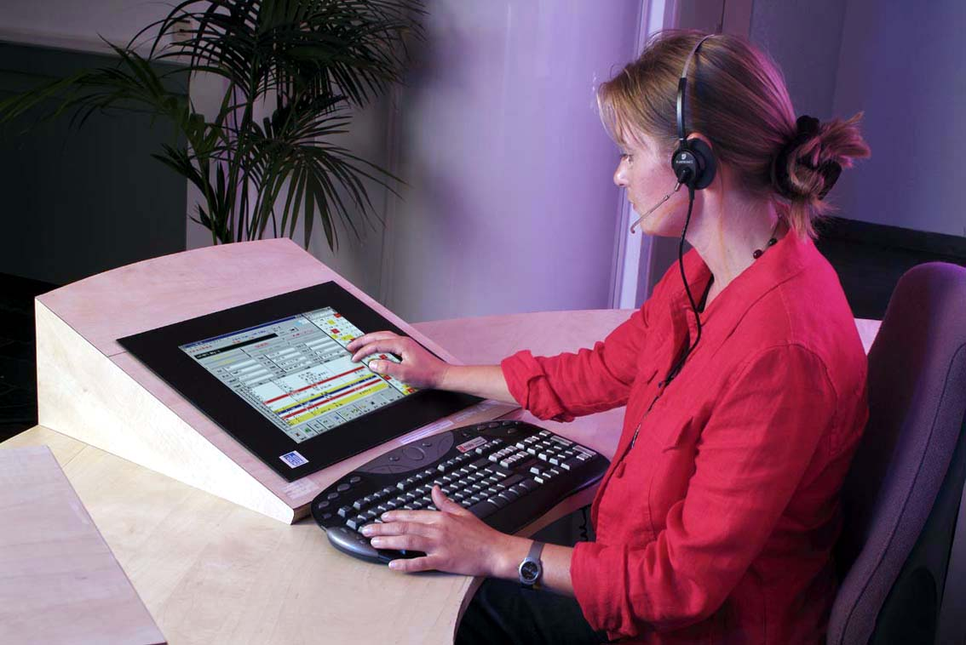
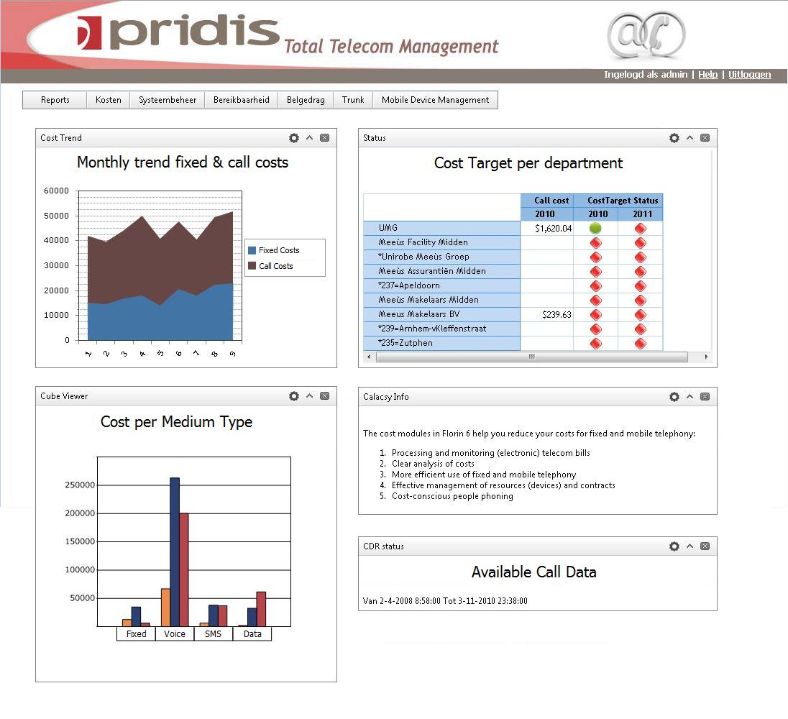


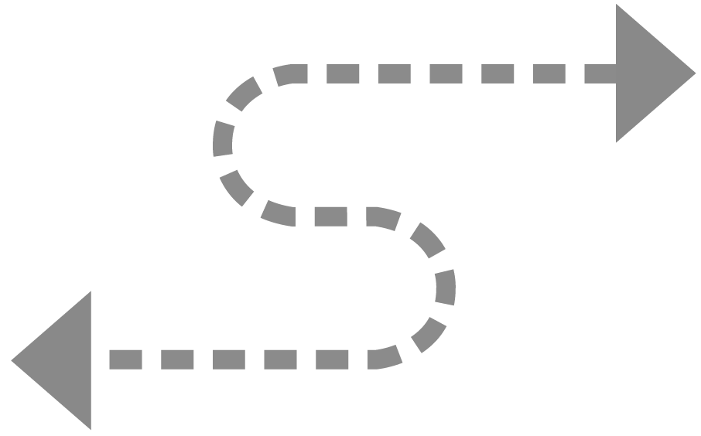

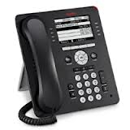



Pridis main Products Portfolio
Attendant Consoles
Telecom Management
Reporting and BI
Fixed & Mobile Costs
Call Performance
Connecsy Enterprise
Connecsy
Single Sign-On
Paging Integration
ICT Workflow &
Data Integration
SSO
ESPA

Slide 4

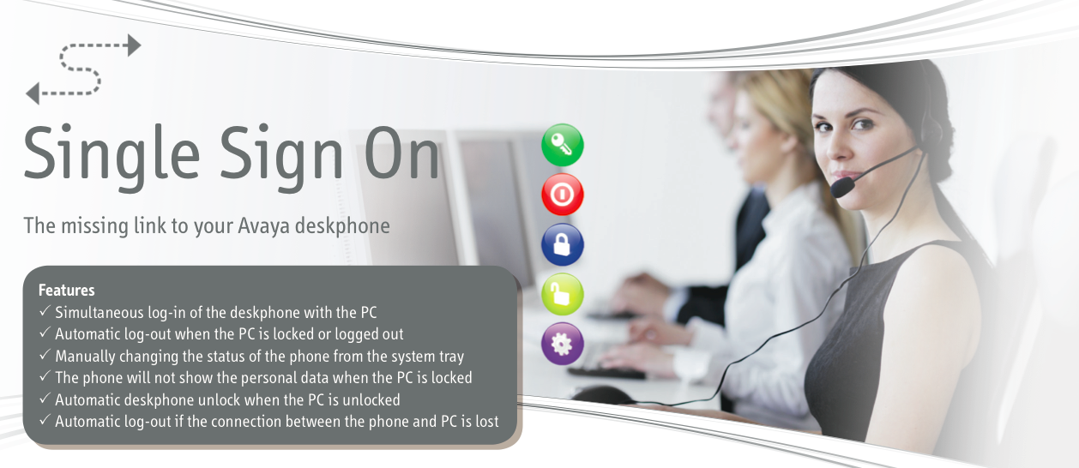
Introducing: Single Sign-On
The missing link to Your Avaya deskphone!

Slide 5
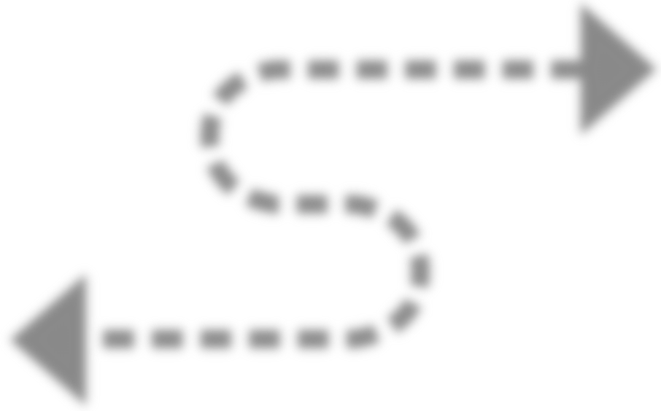
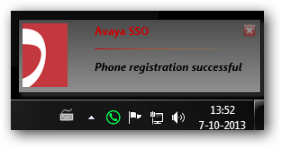

Single Sign-On: Architecture
The User logs in:
The PC will detect that the phone is supporting the SSO feature
The SSO solution will send the extension and user password to the phone
The phone will log-in
The User logs out:
The SSO solution will sent the log-out request to the Phone

Slide 6
Single Sign-On: How does it work?
User logs in
The PC detects that the phone supports the SSO feature
The SSO solution sends extension + user-password to the phone
The phone will Log-in
User logs out
The SSO solution sends log-out request to the Phone
The phone will Log-out
The User logs in:
The PC will detect that the phone is supporting the SSO feature
The SSO solution will send the extension and user password to the phone
The phone will log-in
The User logs out:
The SSO solution will sent the log-out request to the Phone

Slide 7

Single Sign-On – Additional Features
Wake-up
Automatic lock of the phone if the PC locks
Protect personal data like Contacts and Call Log
Automatic unlock of the phone when the PC is unlocked
System Tray
manually change settings and the status of the phone
The User logs in:
The PC will detect that the phone is supporting the SSO feature
The SSO solution will send the extension and user password to the phone
The phone will log-in
The User logs out:
The SSO solution will sent the log-out request to the Phone

Slide 8


Introducing: Connecsy Enterprise

Slide 9
Connecsy Enterprise – Highlights
UC-Vendor Independent
Intelligent Queues
Full Attendant Control - choose and pick
Multi-Attendant, Centralized Queues
UC Presence Information
  Multi Vendor Telephony
  Calendar
  MS Lync Integration
Extended Directory Information

Slide 10




Connecsy Enterprise – User Interface
Queues
Personal
Workspace
Chat
VIP’s
Efficient
& Easy
Attendant
Workflow
Directory +
Presence
Calendar

Slide 11



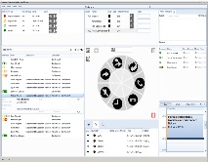








Connecsy Enterprise Architecture
Telephony
(UC) System
Communications Appliance
Connecsy Application Server
Trunks
(SIP, ISDN etc)
Connection
Manager
Media Server
IPOffice
Presence
Connecsy Enterprise Clients
Business Applications
Data Service
Presence Adapters
Proprietary
Reporting
Engine
Hi-Way
Directory
Reporting
AD

Slide 12





Meet us
at our Booth!
www.pridis.com:
End of presentation
  Berencamperweg 6-b 3861MC Nijkerk (Gld)
  P.O.box 1193 3860BD Nijkerk (Gld) The Netherlands
  sales@pridis.com

