Slide 1


OpenScape Business
Pay As You Go
Michael Trotz,
Product Manager@UNIFY

Slide 2

Agenda
  Offering
  Motivation
  Competitive Advantage
  Order Process & Billing
  Pricing
  Economic Model
  Deployments
  Summary

Slide 3
Agenda
  Offering
  Motivation
  Competitive Advantage
  Order Process & Billing
  Pricing
  Economic Model
  Deployments
  Summary

Slide 4

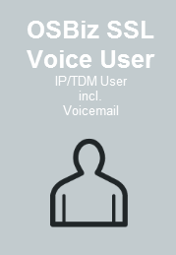
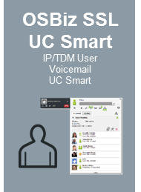
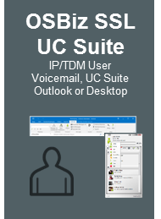
OpenScape Business Pay As You Go
New Subscription Software Licensing Model (SSL)
Flexible Payment Model based on monthly usage (OPEX)
Voice & UC pre-packaged
Available for all Deployments
Software Support always included
Additional Pay As You Go
Licenses available
Please note: Pay As You Go is not yet released to NAM – please get in contact with your local UNIFY Partner Manager

Slide 5
What means…
Pay As You Go
It is a Unify Marketing term and stands for the OpenScape Business Subscription Software Licensing (SSL) option
CAPEX
Capital expenditure or capital expense ("capex") is an expense where the benefit continues over a long period, rather than being exhausted in a short period. Such expenditure is of a non-recurring nature and results in acquisition of permanent assets. It is thus distinct from a recurring expense.
OPEX
An operating expense, operating expenditure, operational expense, operational expenditure or OPEX is an ongoing cost for running a product, business, or system.
SSL Subscription Software Licensing
The subscription business model is a business model where a customer must pay a subscription price to have access to the product/service. Rather than selling products individually, a subscription sells periodic (monthly or yearly or seasonal) use or access to a product or service
Source in cursive letters taken from: https://en.wikipedia.org

Slide 6
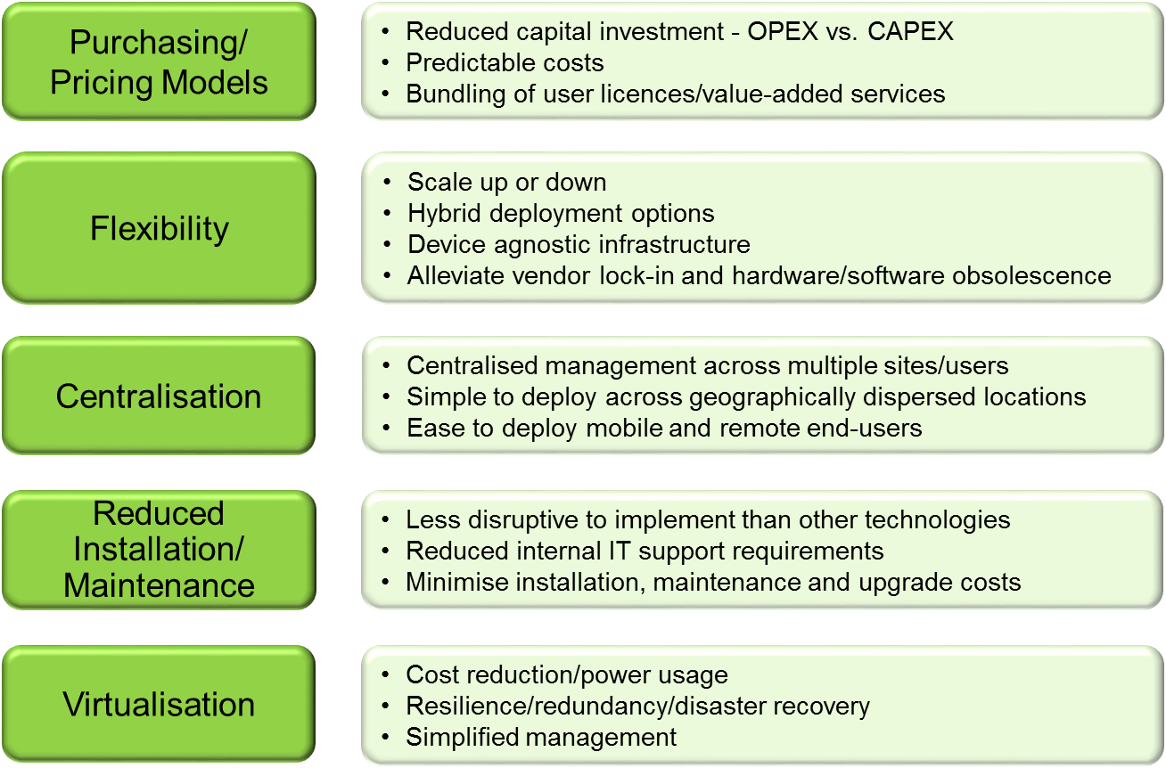
Pay Per Use – a Market Driver
Pay Per Use pricing models today are associated to hosted/Cloud Offerings (but why ?)
MZA Hosted/Cloud Business Telephony Report
Because of the market trends
customers looking for a:
flexible „pay per use“ (OPEX) solution
„Scale up or down“ and
adopt solution to customer needs
with predictable costs
Hybrid Deployment Options: hosted/on-premise
Supporting market trends: Anywhere Worker
Easy to deploy / Simplified Management
Left Chart taken from MZA 2015 Hosted/Cloud Business Telephony Report

Slide 7
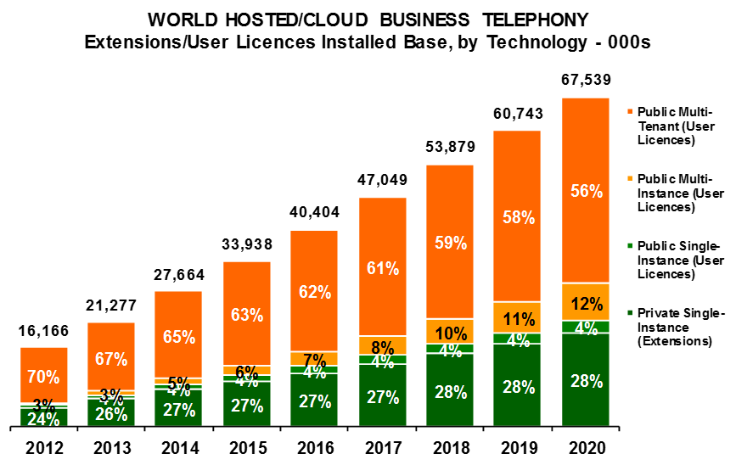
Pay As You Go – a huge business opportunity for Partners
Adressable Market Size for Pay Per Use will grow from 2016 to 2020 by up to 45%
Customers from 30-500 Users looking for a Single to Multi Instance Solution (deployed out of a private or Public Datacenter), green marked
Smaller Customers looking for Public Cloud Offerings, but barrier to adaption among others are Security Concerns & lower feature sets
It is a request from YOU as our UNIFY Partners
OpenScape Business Pay As You Go perfectly fulfill these Market Requirements
Flexible Payment is available for all deployments incl. traditional on-premise, hosted and private Cloud
* Chart and findings taken from MZA 2015 Hosted/Cloud Business Telephony Report

Slide 8
Agenda
  Offering
  Motivation
  Competitive Advantage
  Order Process & Billing
  Pricing
  Economic Model
  Deployments
  Summary

Slide 9
What is the benefit of Pay As You Go to Partners?
1
Ownership: Partners keep overall responsibility for the customer which increases customer loyalty. This also includes contract ownership
Predictable Revenue: Generates a recurring revenue stream along with the potential for additional business opportunities.
Cloud Alternative: Allows partners to compete and win against traditional public cloud offerings with an even more flexible subscription model
Financial Management: No need for partners to make a large upfront investment. Allows partners to handle larger customer projects
Simplicity: The OSBiz SSL model allows it to be sold like any other product. No additional training or certification requirements are necessary
2
3
4
5

Slide 10
What is the benefit of Pay As You Go to Customers?
1
Flexibility: The Pay As You Go model offers customers flexibility to invest only in the number of users and features they need
Cost Management: There is no need for customers to make a large upfront investment. The monthly payment option based on operational costs (OPEX) allows them to better manage and control their payment streams
Cloud Alternative: Provides customers with different options when compared to traditional public cloud offerings, eg. choice of different deployments
Software Support is always included to ensure that customer have the latest features, software and security options, without incurring additional costs.
Adaptability: It fits perfect for companies whose business models are project-based or seasonal in nature. This includes contact centers, temporary projects, or a freelance /remote workforce which acts as an extension of the business
2
3
4
5

Slide 11
Agenda
  Offering
  Motivation
  Competitive Advantage
  Order Process & Billing
  Pricing
  Economic Model
  Deployments
  Summary

Slide 12
Advantage Pay As You Go compared to…
Traditional Cloud Offerings
OpenScape Business
Pay As You Go
Traditional Cloud model
Indirect
Carrier or Large
organizations
Partner with OSBiz Product
Partner
Sales
Process
Direct
Contractual
relation
Sales
Process
Direct
Contractual
relation
Customer
Customer
Traditional Cloud model is a business
RISK for many partners
Partners can keep their business model and
can compete against Traditional Cloud offerings

Slide 13


Advantage Pay As You Go compared to…
Traditional Cloud Offerings from a Technical Perspective
OpenScape Business
Pay As You Go
Traditional Cloud model
Multi-Tenant communication infrastructure
Multi-Instance
IP Communication
Customer Datacenter
IP Communication
&
@cloud
TDM; DECT; FAX;
Door opener..
@cloud
@cloud
@cloud
@cloud
@cloud
IP focused with option for TDM
provides much more flexibility
“only” IP focused

Slide 14
Agenda
  Offering
  Motivation
  Competitive Advantage
  Order Process & Billing
  Pricing
  Economic Model
  Deployments
  Summary

Slide 15




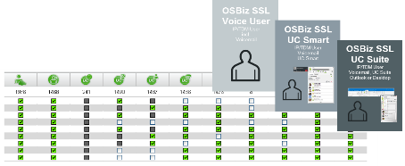
How to Order & Proceed (Overview)
Order OSBiz SSL Base License at 0€ costs
Includes already Software Support, Networking & Auto Attendant Licenses
1
Choose the right deployment model & Phones
OpenScape Business System (S/X) & Phones needs to be purchased as usual, Installation and Configuration of the OpenScape Business Systems happens as usual, OSBiz SSL Base License needs to be activated first
2
Select the right Feature Licenses / add additional Values (SIP Trunks, Contact Center, etc.) as needed
Licenses needs to be assigned within OSBiz WBM License Dialog
3
Receive your monthly invoice via your Distribution Partner
OpenScape Business reports license usage back to UNIFY and sent invoice to Distribution Partner

Slide 16
1
Order OSBiz SSL Base License at 0€ costs
Details
Can only be “purchased” via your “on-boarded” Distribution Partner (signed SSL Amendment)
Two different OpenScape Business SSL Base Licenses are available: One for OSBiz X1 and one for OSBiz X3/X5/X8/S
The OSBiz SSL Base License needs to be activated on an Endcustomer CLS Account (as usual with any other License)
With the Activation of the OSBiz SSL Base License all Pay As You Go Features can be assigned, for e.g. max no. of Voice/UC Users
OSBiz SSL Base Licenses are the only SSL Licenses which can be ordered, all other SSL Licenses (L-Numbers) are just for billing purposes

Slide 17

2
Choose the right deployment model & Phones
Details
Pay As You Go can be used with all OSBiz Deployments and all different type of phones (IP, TDM, DECT, analog, etc.)
OpenScape Business System & Phones needs to be purchased as usual (CAPEX) by Customers – not part of Pay As You Go Offering
OpenScape Business Installation & Configuration happens as usual
Internet Connection for Pay As You Go is required (send Reports to CLS)
Pay As You Go can also be used in an OSBiz Network and requires an OSBiz Base SSL License for each node (local licensing support)
Details about Deployment Options can be found in Chapter “Deployments”

Slide 18
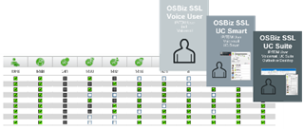
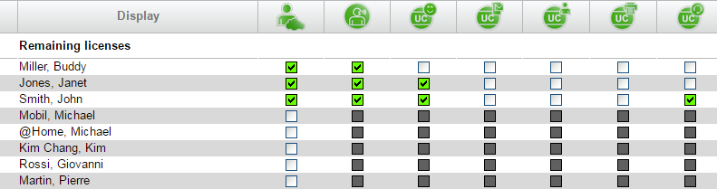
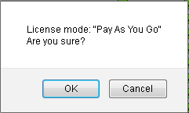
3
Select the right Feature Licenses / …
Details
After the Activation of the OpenScape Business Base SSL License all SSL features can be assigned in the regular WBM License Dialog
3 types of Voice & UC Users are pre-packaged and additional features like UC Conference can be assigned on top, like in the following example:
User
Voicemail
UC Smart
Conference
OSBiz SSL UC Smart User
+ UC Conference
…confirmation required
Billing starts when feature licenses are assigned to a User / System

Slide 19
Pay As You Go / SSL License Mapping
OpenScape Business License * | Plus | Plus | charged as**:
OpenScape Business IP / TDM / Mobility / DeskShare User | + Voicemail |  | OpenScape Business SSL Voice User
OpenScape Business IP / TDM / Mobility / DeskShare User | + Voicemail | + myPortal Smart | OpenScape Business SSL UC Smart User
OpenScape Business IP / TDM / Mobility / DeskShare User | + Voicemail | + Groupware User / UC User | OpenScape Business SSL UC Suite User
OpenScape Business Fax |  |  | OpenScape Business SSL Fax
OpenScape Business Conference |  |  | OpenScape Business SSL Conference
OpenScape Business myAttendant |  |  | OpenScape Business SSL myAttendant
OpenScape Business myAgent |  |  | OpenScape Business SSL myAgent
OpenScape Business Application Launcher |  |  | OpenScape Business SSL Application Launcher
OpenScape Business TAPI |  |  | OpenScape Business SSL TAPI
System Licenses:
OpenScape Business OpenDirectory Connector |  |  | OpenScape Business SSL OpenDirectoy Director
OpenScape Business Contact Center Fax |  |  | OpenScape Business SSL Contact Center Fax
OpenScape Business Contact Center E-Mail |  |  | OpenScape Business SSL Contact Center E-Mail
OpenScape Business myReports |  |  | OpenScape Business SSL myReports
OpenScape Business S2M/SIP/T1 Trunks |  |  | OpenScape Business SSL S2M/SIP/T1 Trunks
✓
* License Name shown up in OpenScape Business Assistant (WBM) License Dialog
** SSL Marketing Term visible in UNIFY Invoice to Distribution Partner
Software Support, Networking, Auto Attendant and Web Collab Connector always included
OpenScape Business Attendant and GateView are not part of Pay As You Go / SSL Offering

Slide 20
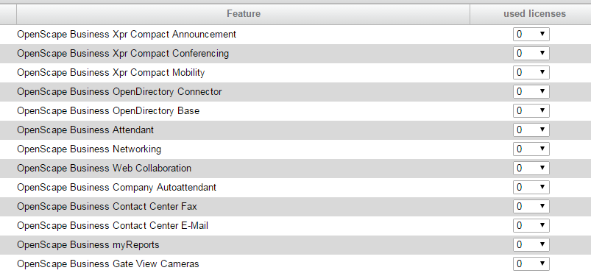



Good to know
OpenScape Business Assistant License Dialog (WBM)
After the activation of the OpenScape Business SSL Base License File within OpenScape Business Assistant (WBM) please set back “system licenses” to zero within the first two hours in case these Licenses are not needed by customer:
  OpenDirectory Connector
  Contact Center E-Mail, Fax and myReports
  This is required because Grace Period Mode was active before with all system licenses activated
  OpenScape Business requires an Internet connection to UNIFY CLS(Central License Server), following settings are required:
    Open Ports 7780 and 7790 for incoming/outgoing traffic within Customers Firewall
    CLS IP 188.64.16.4 released for incoming and outgoing IP traffic
  If no Internet Connection is detected OSBiz went into “Failover Mode” for 30 days
Please set licenses back to 0
in case these are not needed by the customer!
CLS
Ports needs to be open in a Firewall,
often needed in restrictive Datacenter environments,
to reach the CLS as usual for Online License Activation

Slide 21
Reporting and Billing Period
Billing Period: 16th of a month (0.00am) until 15th of the following month (11.59pm) based on High Watermark Consumption Report (means the max. number of quantities with the highest amount during billing period)
Monthly Report (CSV File) will be sent out on the 16th of each month with the usage, all required Partner and OSBiz System details to Distribution Partner (via email to CLS Primary address)
Monthly Invoice from UNIFY to Distribution Partner will be sent out on the 25th of each month
Partners get their Invoice from their Distribution Partner where they have “purchased” their OSBiz SSL Base License

Slide 22
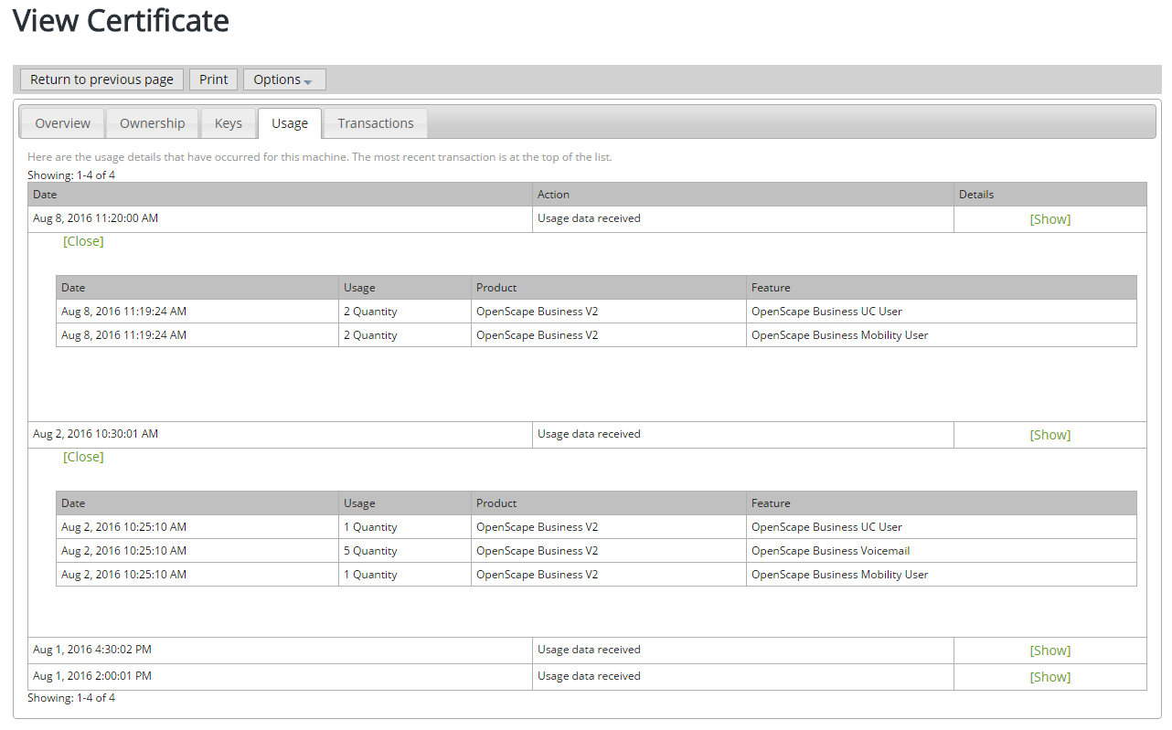
Usage Report on CLS
Usage of licenses can be found on Central License Server (CLS) and be “controlled” anytime by Partners / Customers
Incremental Usage Report showing High Watermark Figures

Slide 23
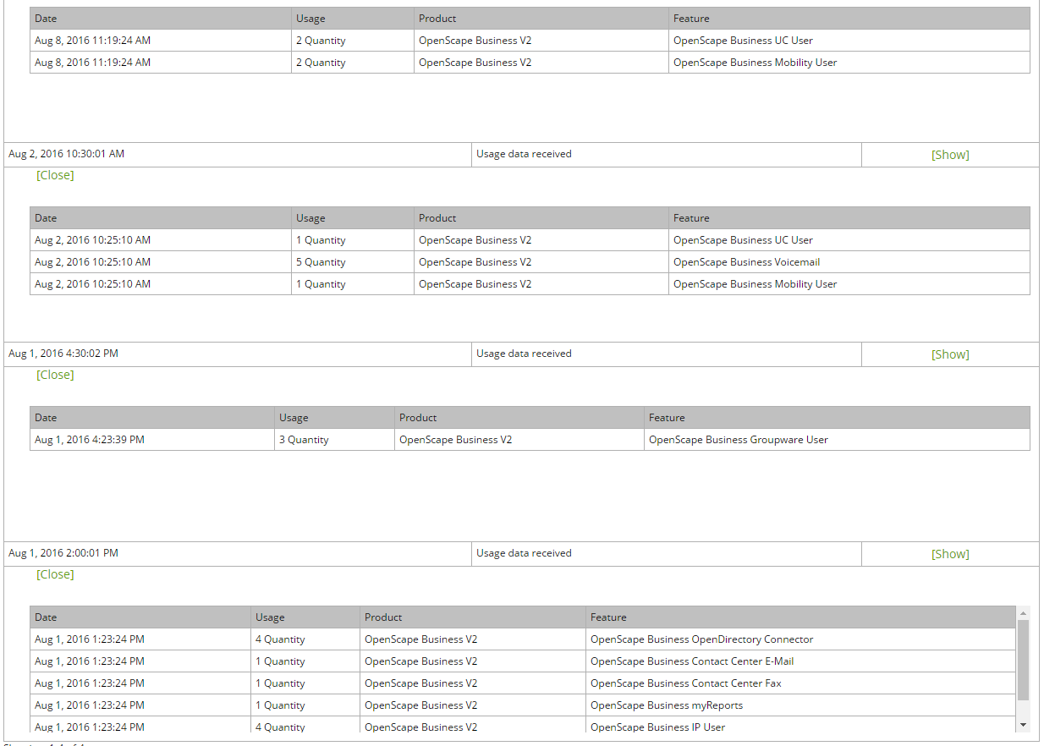
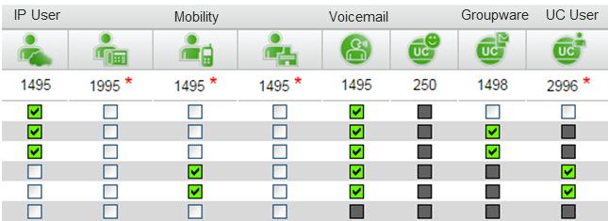
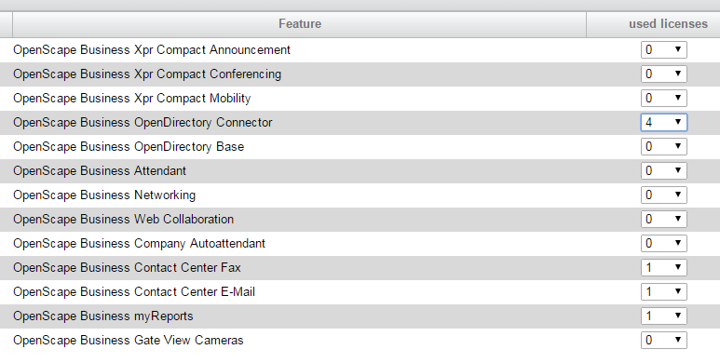
Assigned Licenses visible in CLS Usage Report
3 Groupware Users / 4 IP Users have been activated before
(High Watermark Concept – highest Quantity always shown in CLS Usage Report)
Example

Slide 24
Agenda
  Offering
  Motivation
  Competitive Advantage
  Order Process & Billing
  Pricing
  Economic Model
  Deployments
  Summary

Slide 25
Order Positions and Pricing
Additional Pay As You Go SSL Licenses
(only for monthly payment, can not be ordered,
just shown up in price list)
OSBiz SSL Base Licenses
(only these 2 Positions can be ordered via distribution and regular ordering tools

Slide 26
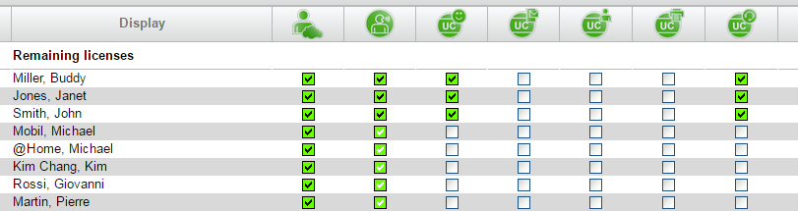
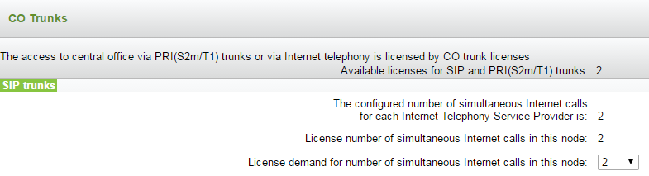
Calculation Example
User
Voicemail
UC Smart
Conference
3 x OSBiz SSL UC Smart User 24,00€
5 x OSBiz SSL Voice User 20,00€
3 x UC Conference 09,00€
1
2
2 x OSBiz SSL S2M/SIP/T1 4,20€
1 x OSBiz Base License 110,00€
8 x Software Support Renewal 192,00€
Networking 825,00€
Auto Attendant 275,00€
3
Software Support, Networking
and Auto Attendant License always in
Pay As You Go - Monthly Payment (GLP)*: 57,20€
* Discount based on regular UNIFY Partner Status

Slide 27

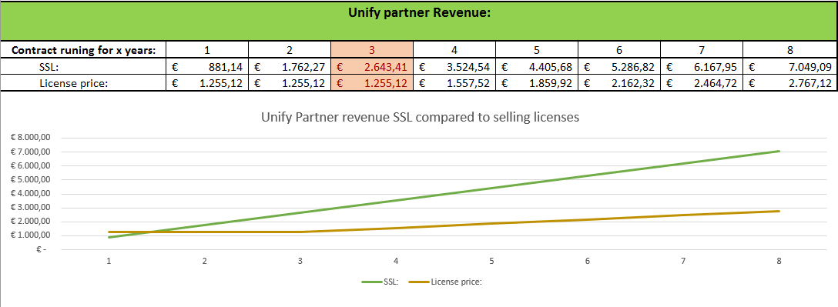
Your chance to earn more
Example: 60 User incl. UC Suite, 30 SIP Trunks, 42% Partner Discount (20% „margin“ to customer)
After 1 ½ year Pay As You Go will deliver additional Partner Revenue compared to selling one time license price (depends on customer configuration).
Please use the SSL Calculation Tool for further Pay As You Go Configurations.

Slide 28
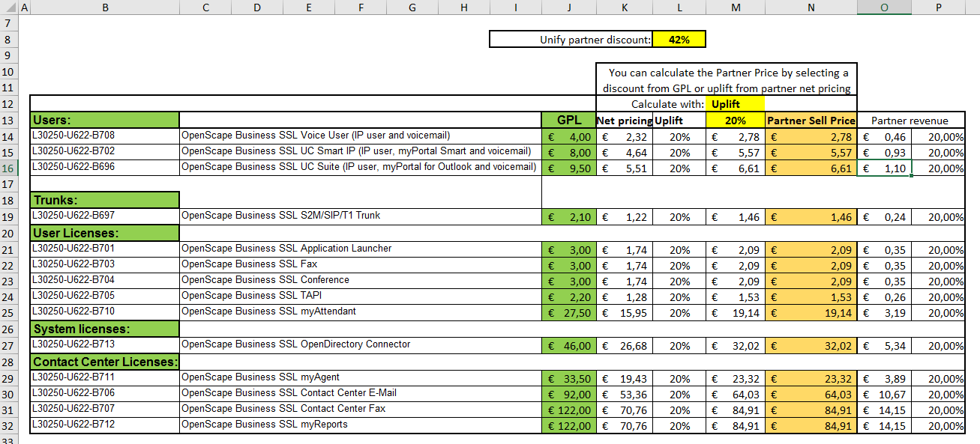

SSL Calculation Tool can be found in UNIFY Partner Portal

Slide 29
Agenda
  Offering
  Motivation
  Competitive Advantage
  Order Process & Billing
  Pricing
  Economic Model
  Deployments
  Summary

Slide 30
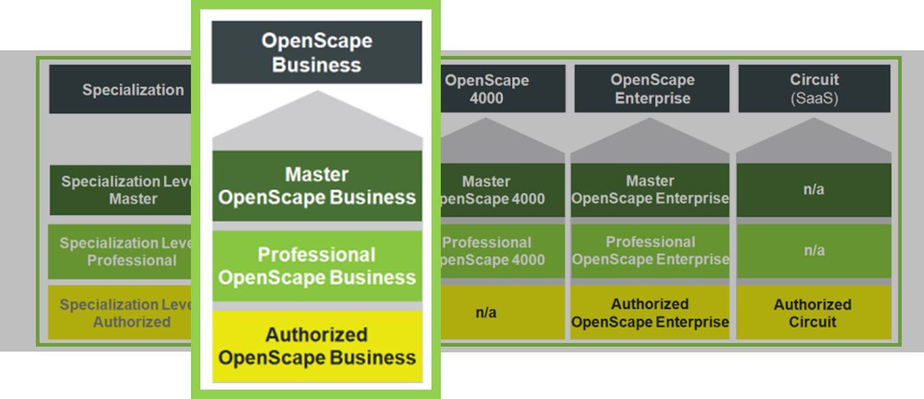
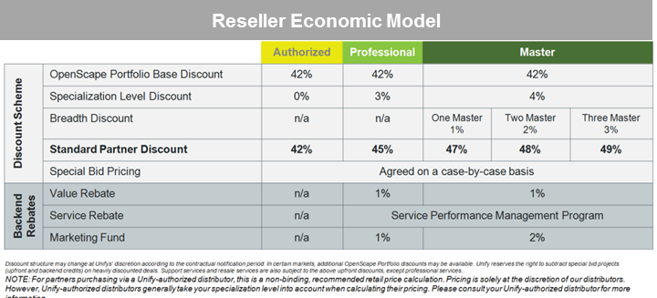
Economic Model / Partner Program
Due to simplicity of the model, OpenScape Business Pay As You Go will be sold as any other Standard Product.
OpenScape Business Certification will remain the same
Economic Model for Distributors and Resellers will remain the same
UNIFY Partner ID required (for invoicing)
Regular Discount Scheme – no Project Pricing

Slide 31
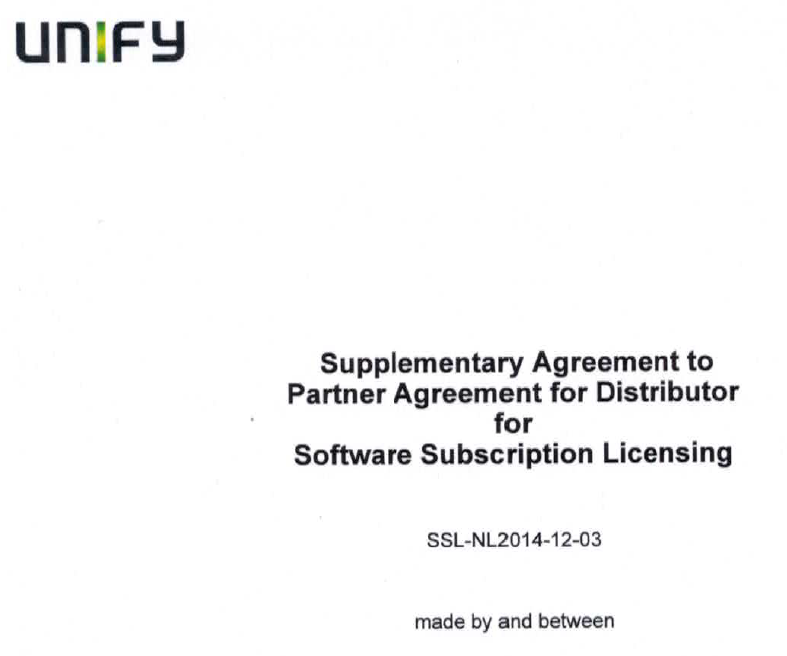
Call to Action for Distribution Partners
Distribution Partner needs to sign the SSL amendment with UNIFY first
  Required to order the OSBiz SSL Base License
  Required to proceed with Pay As You Go
  Required to receive Invoice from UNIFY
  Please get in contact with your UNIFY Partner or Distribution Account Manager
✓

Slide 32
Agenda
  Offering
  Motivation
  Competitive Advantage
  Order Process & Billing
  Pricing
  Economic Model
  Deployments
  Summary

Slide 33





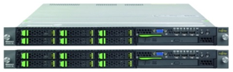
Deployment Options
OpenScape Business X/S (stand alone) Installation & Configuration as usual, supporting all infrastructures and interfaces
OpenScape Business X/S (networked) Each system requires an OSBiz Base SSL License (local licensing)
OpenScape Business X/S Permanent & SSL (networked) Expand existing OSBiz system (permanent licensing) with another OSBiz SSL licensed system as an flexible option
OpenScape Business S in hosted/cloud deployments Deployed out of a Datacenter(Multi Instance), owned and hosted by a Partner or Customer itself
X or S Model
networked
X8 permanent Licensing
X3 SSL Licensing
OpenScape Business S

Slide 34


OpenScape Business S in hosted/cloud deployments
Full featured OpenScape Business S operated out of a Datacenter
Multi Instance Solution hosted by a Partner or Customer
Own virtualized OSBiz S Instance per Customer (private Cloud)
Easy Deployment (~15min) via OVA (Open Virtualization Appliance)
Trusted private cloud
Operation Center
Multi Instance
One OSBiz S instance per customer hosted from a Datacenter Service Provider
Data Center
OpenScape Business S with Pay As You Go – a perfect business model for Partners to offer a flexible payment model on top of a secure and trustful landscape

Slide 35
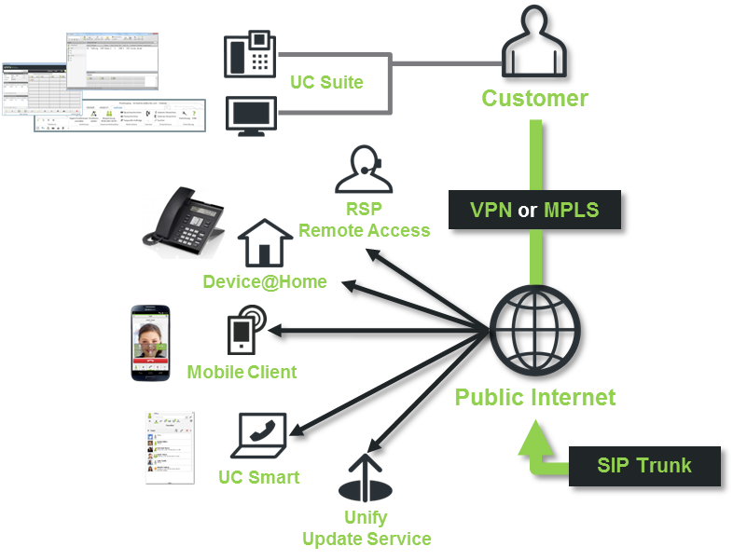
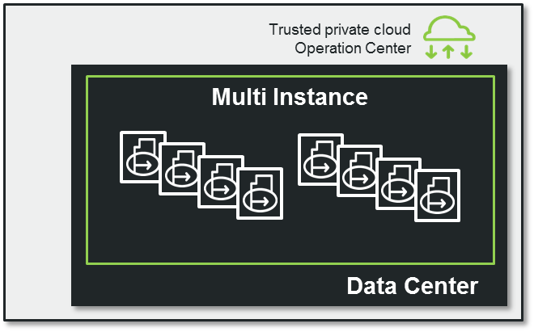

OpenScape Business S hosted/cloud - Overview
Multi Instance Solution with Access to all Features and Interfaces
Easy to connect Interfaces
System Configuration & Services by Reseller
MS Exchange
LDAP
Others
Deploy OVA and Setup IP Interface by Data Center

Slide 36
Calculation Example for OpenScape Business S incl. Datacenter Costs and Pay as You Go Pricing
* estimated costs for Datacenter Service Provider for OSBiz S Instance

Slide 37
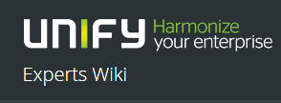
Technical Information
Datacenter and Cloud Deployments http://wiki.unify.com/wiki/OpenScape_Business#Data_Center_and_Cloud_Deployments
Device@Home Configuration http://wiki.unify.com/images/a/ae/How_To_Configure_System_Device%40Home_V2R2.pdf
OpenScape Business Administrator Documentation

Slide 38
Agenda
  Offering
  Motivation
  Competitive Advantage
  Order Process & Billing
  Pricing
  Economic Model
  Deployments
  Summary

Slide 39



Advantage Pay As You Go - Summary
It´s a unique offering: A Pay Per Use Model for all deployments and all infrastructures (hosted, private cloud, on-premise)
Focused on Partners: Keep full responsibility and Contract Ownership
Provides additional business opportunities and generates a recurring revenue stream
Win against traditional Cloud Competitors – our offering provides much more flexibility (full featured, choice of Provider)
No special certification required. All UNIFY Partners can start today and “purchase” Pay As You Go via their on-boarded Distribution Partner

Slide 40

Any Questions?
We´re here to help and support
Q & A
Notes:
We want to ensure you have all the support you need to be successful with the introduction of Software Support V2
To get there, your Unify Channel Managers are ready to help answer your questions.

Slide 41


Let´s Pay As You Go!
OpenScape Business –
and you can even make calls with it!
Thank You!

